Slide 1
Introduction to MongoDB

Slide 2
The Basics
A MongoDB instance may have zero or more databases
A database may have zero or more ‘collections’.
A collection may have zero or more ‘documents’.
A document may have one or more ‘fields’.
MongoDB ‘Indexes’ function much like their RDBMS counterparts.

Slide 3
MongoDB profile
Document-oriented NoSQL database.
Schema-free.
Based on Binary JSON;
Organized in Group of Documents → Collections
Informal namespacing
Auto-Sharding in order to scale horizontally.
Simple query language. Rich, document-based queries.
Map/Reduce support
Open Source (GNU AGPL v3.0.)

Slide 4
MongoDB vs. RDBMS
Collection vs. table
Document vs. row
Field vs. column
Collection isn't strict about what goes in it (it's schema-less)

Slide 5
What is MongoDB?
MongoDB is:
Cross-platform.
Open source.
Non-relational.
Distributed.
NoSQL.
Document-oriented data store.

Slide 6
Why MongoDB?
Open Source
Distributed
Fast In-Place Updates
Replication
Full Index Support
Rich Query Language
Easy Scalability
Auto sharding

Slide 7
Why use MongoDB
Simple queries
Makes sense with most web applications
Easier and faster integration of data
Not well suited for heavy and complex transactions systems.

Slide 8
JSON
JavaScript Object Notation
Minimal
Textual
Subset of JavaScript

Slide 9
JSON
A Subset of ECMA-262 Third Edition.
Language Independent.
Text-based.
Light-weight.
Easy to parse.

Slide 10
JSON Is Not...
JSON is not a document format.
JSON is not a markup language.
JSON is not a general serialization format.
No cyclical/recurring structures.
No invisible structures.
No functions.

Slide 11
JSON (Java Script Object Notation)
Sample JSON Document
{
FirstName: John,
LastName: Mathews,
ContactNo: [+123 4567 8900, +123 4444 5555]
}

Slide 12
Unique Identifier
Each JSON document should have a unique identifier. It is the _id key.
Database
Collection
Document
0 | 1 | 2 | 3 | 4 | 5 | 6 | 7 | 8 | 9 | 10 | 11
Timestamp |  |  |  | Machine ID |  |  | Process ID |  | Counter
_id is the primary key on elements in a collection; with it, records can be differentiated by default.
ObjectId values should increase over time

Slide 13
Terms Used in RDBMS and MongoDB
RDBMS | MongoDB
Database | Database
Table | Collection
Record | Document
Columns | Fields / Key Value pairs
Index | Index
Joins | Embedded documents
Primary Key | Primary key (_id is a identifier)

Slide 14
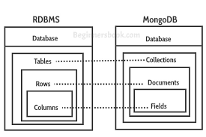

Slide 15
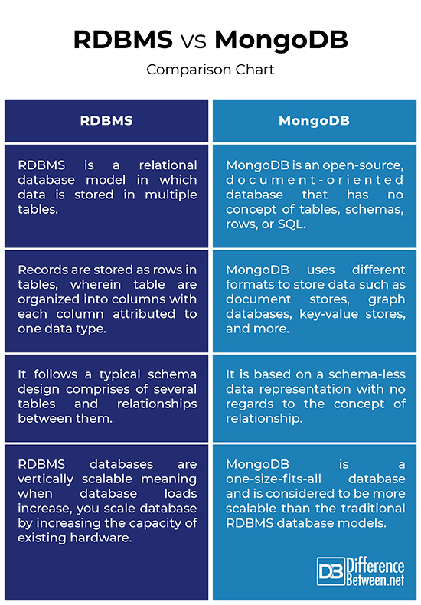

Slide 16
Document-oriented data model
MongoDB uses a document-oriented model using collections
Main characteristics:
Schema-less
Collections can be created on-the-fly when first referenced
Capped collections: Fixed size, older records dropped after limit reached
Collections store documents

Slide 17
MongoDB Document
Main characteristics:
Are represented in a format called BSON (Binary JSON)
Data is de-normalized
No joins → Embedding & Linking
{
author: ‘Lucero',
created: Date(‘06-06-2012'),
title: 'Yet another blog post',
text: 'Here is the text...',
tags: [ 'example', ‘lucero' ],
comments: [ { author: 'jim', comment: 'I disagree' },
{ author: 'nancy', comment: 'Good post' }]
}

Slide 18
Storing irregular data
Example: Different information in user profiles
MongoDB
Each document can have different information
doc1 = {name: “Joe”, age: ”20”, interest: ”football” }
doc2 = {name : “Michele”}
Relational database
Tables with all attributes
NULL value in columns where data was not provided
Results: Special queries to handle NULL values → Expensive

Slide 19
Managing large binary data
MongoDB
Divide a large file among multiples documents (GridFS)
Include metadata to large files
Search files base on its content
Retrieve only the first N bytes of a video
Relational database
Use BLOB (Binary large objects)
Inefficient manipulating rich media
BLOB cannot be searched or manipulated using standard database command

Slide 20
Managing huge volume of data
MongoDB
High performance
No joins and embedding makes reads and writes fast
Indexes including indexing of keys from embedded documents and arrays
Horizontal scalability
Automatic sharding (auto-partitioning of data across servers)
Relational database
Have shown poor performance on certain data-intensive applications and delivering streaming media → Case study: Foursquare
Difficult to scale to multiple servers

Slide 21
Why Replication?
Replication exists primarily to offer data redundancy and high availability.
We maintain the durability of data by keeping multiple copies or replicas of that data on physically isolated servers.

Slide 22
Replication
Replication allows you to increase data availability by creating multiple copies of your data across servers.
This is especially useful if a server crashes or if you experience service interruptions or hardware failure.
If your data only resides in a single database, any of these events would make accessing the data impossible.

Slide 23
Replication
But thanks to replication, your applications can stay online in case of database server failure, while also providing disaster recovery and backup options.

Slide 24
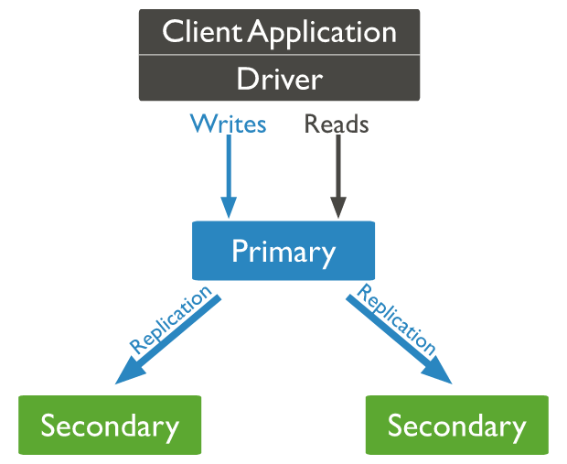
How does replication work in MongoDB?
With MongoDB, replication is achieved through a replica set.
Writer operations are sent to the primary server (node), which applies the operations across secondary servers, replicating the data.

Slide 25
Replication in MongoDB
If the primary server fails (through a crash or system failure), one of the secondary servers takes over and becomes the new primary node via election.
If that server comes back online, it becomes a secondary once it fully recovers, aiding the new primary node.

Slide 26
Thank you

